Slide 1


Supplemental Material
Units and Unit Conversion
Jeffrey D. Naber
Associate Professor
MEEM Department
Michigan Tech University
Email: jnaber@mtu.edu
Tel: 906-487.1938

Slide 2
Assignment 3: Individual
Assignment 3: Unit Conversions
Complete the follow assignment individually by January 30, 10:00AM
APHEV.Assignment.03.doc
On Campus Students
Turn in a paper copy at the start of class
Upload and electronic copy to Canvas with file name "LASTNAME.Assignment.03.pdf" where "LASTNAME" is your last name.
Distance Learning Students
Upload and electronic copy to Canvas with file name "LASTNAME.Assignment.03.pdf" where "LASTNAME" is your last name.
I will record and upload supplemental material to outline the procedure to use.

Slide 3
Method of Unit Conversions & Unit Cancelations

Slide 4
UnitS
Learning Objective: Know how to convert mass, weight, force, work, energy, and power between common SI and English units and apply these to the physical relationships between them.

Slide 5
Unit Conversion Factors
Unit conversions are applied to equations
Need an appropriate equation for a unit conversation

Slide 6
Unit Conversion Factors – Example

Slide 7
Unit Conversion Factors – Example

Slide 8
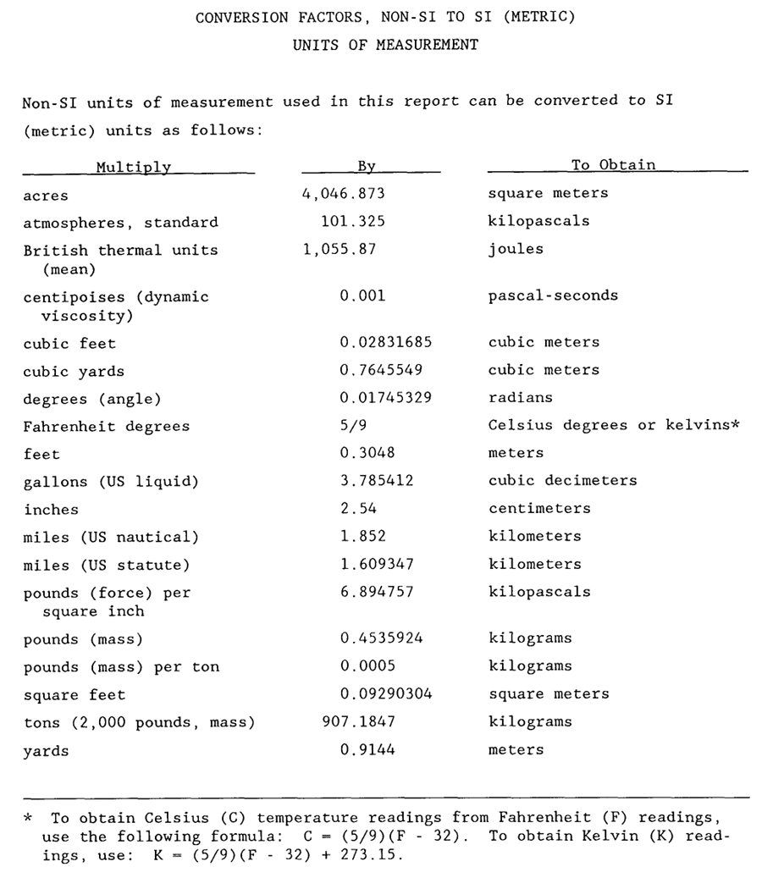
What Makes a Good Table
Tables that are not equivalency equations are confusing
http://www.epa.gov/greatlakes/arcs/EL-90-25/EL-90-25.html

Slide 9
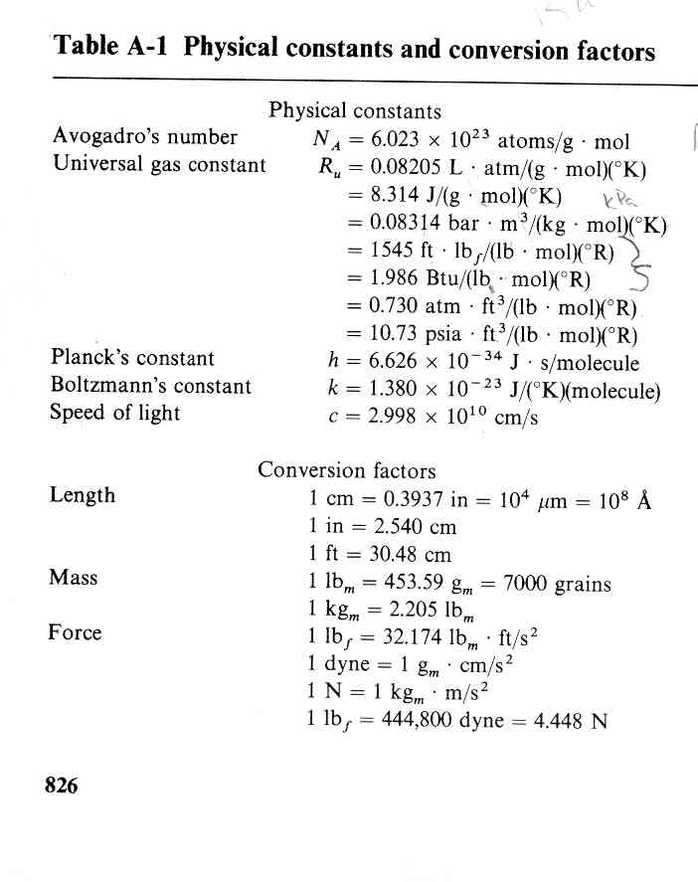
Conversion Factors for Mass & Weight
Prefer one that is in the form x = y; then you can simply multiply by x/y = 1.
1 in/2.540 cm = 1
Pound mass (lbm)
It should differentiate
between mass and weight.
F=m⋅a
Pound force (lbf)
Wark, Thermodynamics, McGraw-Hill, © 1983

Slide 10
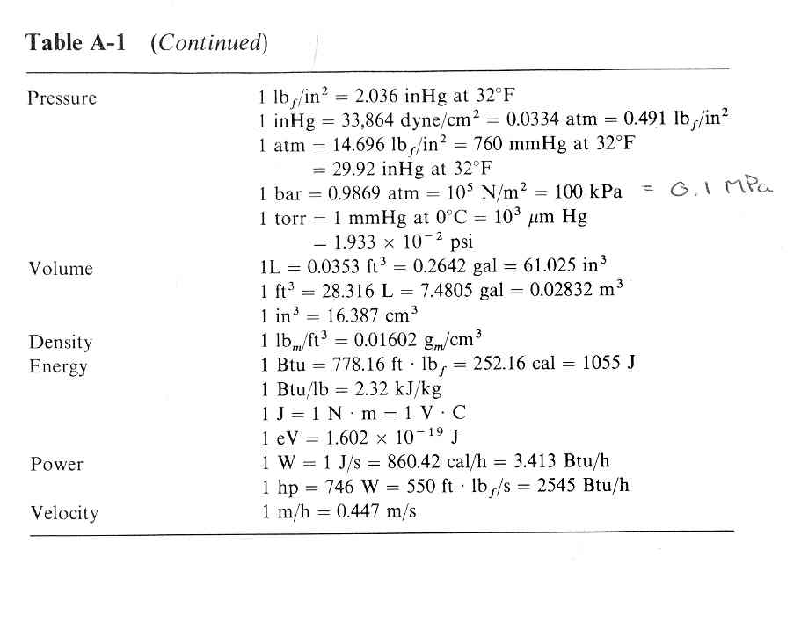
Table Continued
Remember a few key ones.
1 hp = 0.746 kW ≈ ¾ kW
1 BTU = 1055 J
Wark, Thermodynamics, McGraw-Hill, © 1983

Slide 11
Rotational Conversions
1 rev =360° crankangle = 2π radians
1 cycle = 2 rev¹ = 720° crankangle = 4π radians
^{[1]} For a 4-stroke engine. This equates to n_{R} as utilized in Heywood.

Slide 12
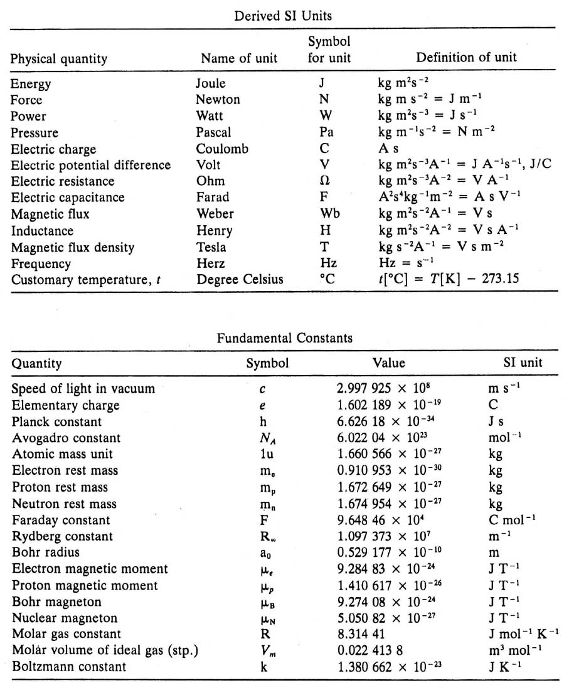
Conversion Factors for Electrical Units
http://131.104.156.23/Lectures/CHEM_207/CHEM_207_Intro.htm

Slide 13
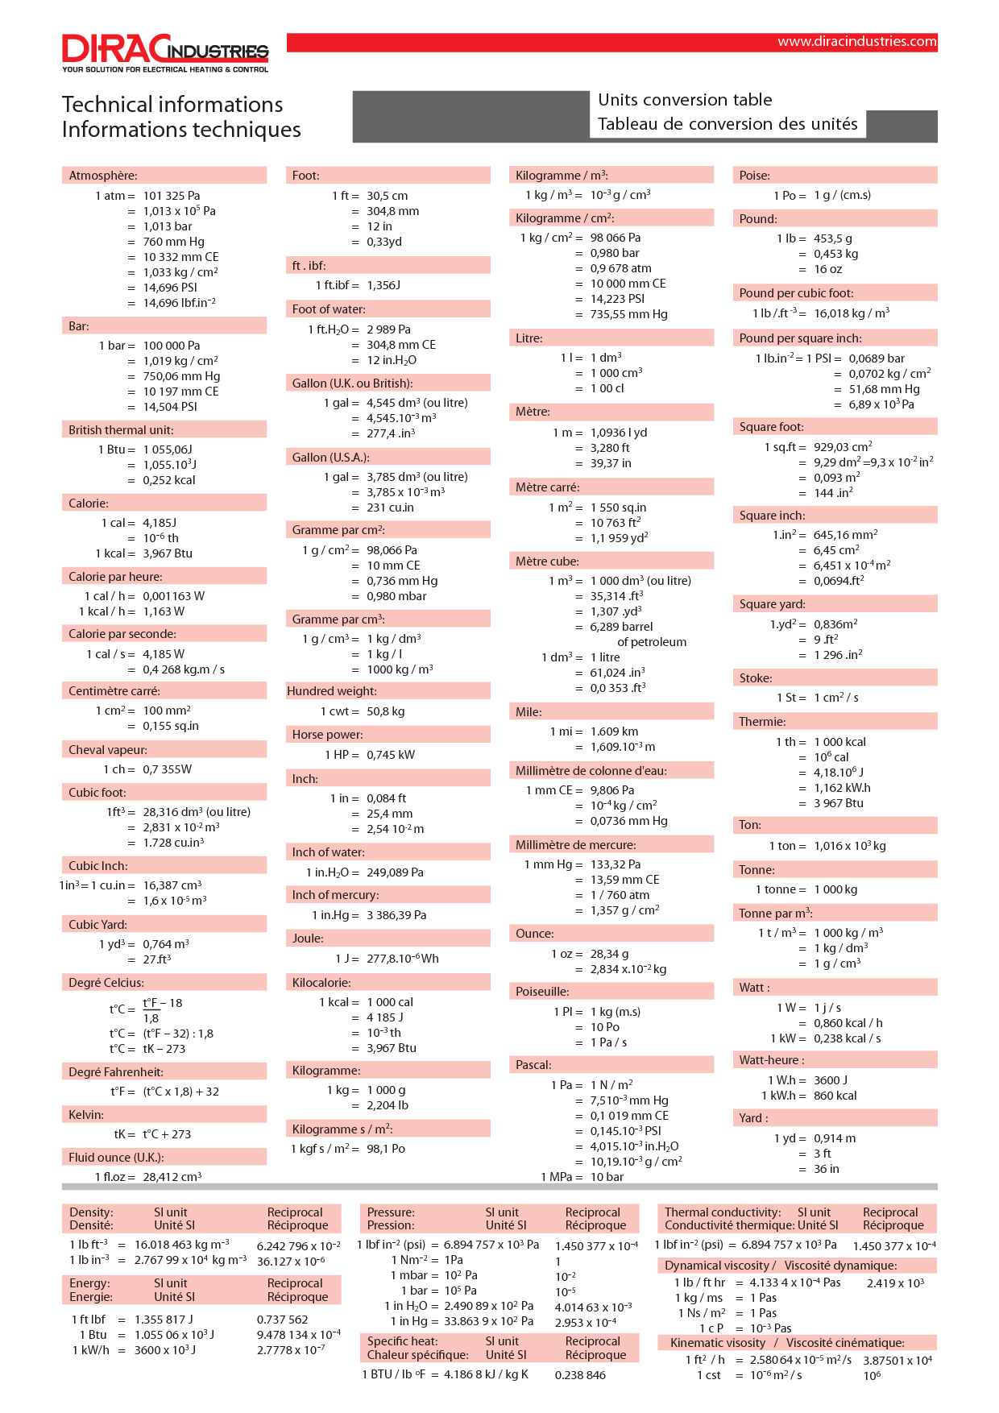

Slide 15
Physical Constants
Wark, Thermodynamics, McGraw-Hill, © 1983

Slide 16
Fundamental Constants
g
http://131.104.156.23/Lectures/CHEM_207/CHEM_207_Intro.htm

Slide 17
Molar Units
Care is required in the use of the mole which is initially confusing for those having studied chemistry using a gram-mole (gmol) and then thermodynamics where kilogram mole (kgmol) is most often used. The mole equivalencies are give as
1 kgmol = 1000 gmol = 2.2 lbmol.
with the corresponding changes in Avegadrow constant
6.02214∙10²³ constituent particles/gmol
or
6.02214∙10²⁶ constituent particles/kgmol

Slide 18
Unit Systems, Conversion and Cancelation
Most analysis and published work is now done in SI units (s, m, kgmol, kg, N, W, K/°C); however, there is a persistence of English units (s, ft, lbmol, lbm, lbf, hp, °R/°F) in application of IC engines, and cgs units (s, cm, gmol, g, dyn, erg or cal, K) in application of chemistry and kinetics. Even in application of SI units there is a need to rationalize and thoroughly check units. A mechanism as applied by Myers (2007) is used and illustrated in this example for determination of power from torque and engine speed (350 ft-lbf, 3500 rpm),
Myers,G.E., Engineering Thermodynamics, 2nd edition, AMCHT publications, 2007, ISBN: 978-0-9666065-2-2.

Slide 19
Unit Systems, Conversion and Cancelation
In this formulation,
The engineering values for the parameters are first evaluated with units written in a ratiometric form and separated by single vertical lines (ǀ).
This is followed by the application of the necessary conversion factors (e.g., 1 min = 60 s) written as ratios (1min/60s =1).
A double line (ǁ) separates the applied parameters and conversion factors. In this form, cancellation of units is easily analyzed and checked.

Slide 20
Physical Terms
http://www.racquetresearch.com/units.htm
Accessed: Sept 11, 2009
Mass is the quantity of matter in the thing you are studying. The metric unit of measurement of mass is the kilogram (kg), which is 1000 grams. The English unit is the slug, which is rarely used. The mass center of an object is where the balance point is.
Weight is a force, which arises when a mass is acted on by gravity. The metric unit of weight should technically be the Newton (N), which is the unit of force, but commonly it is the kilogram of mass that is used to measure weight in the metric system because gravity is about the same everywhere on the Earth. The English unit of weight is the pound (lb).
Length in the metric system is measured by meters (m), and in the English system by feet (ft). A mile is 5280 feet or 1609 meters (1.6 kilometers).
Velocity is how fast something is moving in a certain direction. Remember, direction is key. You can have negative velocity if you are moving in the wrong direction. In the metric system, the unit for velocity is meters per second (m/s). In the English system, it miles per hour (mph).
Momentum is when a mass has a velocity. The unit has no name in the metric or the English system, but it is kg.m/s (mass times meters per second). Note that mass is just as important as speed in calculating momentum, and also note that momentum has a direction. Momentum is conserved in any collision, which means that you add the momenta of the two colliding objects (remembering that velocity can be negative) and the sum of their momenta after the collision must be the same, no matter if they are made of clay or diamond. Conservation of Linear Momentum and Conservation of Angular Momentum are key concepts in elementary mechanics.
Acceleration is the rate of change of velocity: meters per second, per second (m/s²). In the English system, it is feet per second, per second.
Force is when you have a mass being accelerated or decelerated (Newton's Second Law: F = ma) in a certain direction. Because force always has a magnitude (how much) and a direction, it is represented by an arrow (called a vector). The unit of measurement of force in the metric system is the Newton, which is kilograms times meters per second per second (kg.m/s²). In the English system, force is measured in pounds (lbf). The metric unit is much superior for clear understanding of the concept of force, which is frequently confused with energy and momentum. Be sure you know exactly what the difference is. Also, study the difference between force and torque.
Energy, work, and heat are all measured in the metric unit of the joule, which is kg.m²/s² -- you can see that this is Newtons times meters. This unit represents the result of a force moving something a distance, such an accelerating racquet, impelled by the force of the player's muscles contracting (especially the belly muscles), moving to hit a serve. There is a confusing multitude of measurement units in the English system because these units arose before thermodynamics evolved as a science using the fact that energy, work, and heat were all the same thing, and could be interchanged to produce engines. In the English system, the unit of measurement of heat is the Btu (British thermal unit) which is equivalent to 1055 joules. There is also another unit of measurement called the calorie which is used for heat or energy, and is equivalent to 4.186 joules. The calorie used for describing food is actually 1000 calories, and is written with a big C. For work, the English system uses the foot pound (ft.lbf), which is the amount of work or energy used to lift an object weighing one pound a distance of one foot. Energy is also conserved, like momentum, but it shifts forms, unlike momentum, between kinetic energy (the energy of a moving object), to potential energy (the energy that is stored in an object), to internal energy (heat), to work. How much energy is lost in a collision, by being converted to forms other than kinetic energy, is measured by the Coefficient of Restitution (COR). This is the bounce, or more technically, elasticity, and can never be greater than 1.
Torque is a twisting force, and the twist occurs because the force is not applied to the object's mass center so as to be a push. When you put spin on the ball, you impart a torque to it. The impact of the ball imparts a torque to your racquet. The metric unit of measurement is the Newton meter (N.m), which is a force times the distance this force is from an axis of rotation. The English unit is foot pounds or pound feet.
Power is the rate of doing work, and is measured in the metric unit of the watt (W), which is one joule per second. A kilowatt (kW) is a thousand watts. The English unit is the horsepower (hp), which is equivalent to 746 watts, or 2545 Btu per hour, or 550 foot pounds per second. If you weigh 100 pounds and can climb 11 feet of rope in two seconds, you have one horsepower, which is strong. Be sure you understand the difference between power, energy, force, and momentum.

Slide 21
Relationship between Mass & Weight
What is g_{c}?
g_{c} is nothing more than a conversion factor and is required in SI units!

Slide 22
What to do about mass and weight in the English system
Do I apply g_{c} or not?

Slide 23
Relationship between Mass & Weight

Slide 24
Relationship between Mass & Weight
gc is nothing more than a conversion factor. I my option it should not appear in any equations as we don’t include CF normally

Slide 25
Relationship between Mass & Weight
In SI units it turns out to have a numerical value of 1.0.

Slide 26
Conversion Factors for Mass & Weight

Slide 27
Mass and Weight in English Units
1 lbf = 1 lbm
1 lbf is equivalent to 1 lbm in the presences of gravity at 32.174 ft/s²
1 N (=1/4.448 lbf) is equivalent to 1/9.82 kg in the presences of gravity at 9.8067 m/s²
kg > lbm
N < lbf
9.8067/2.205

Slide 28
Fuel Properties

Slide 29
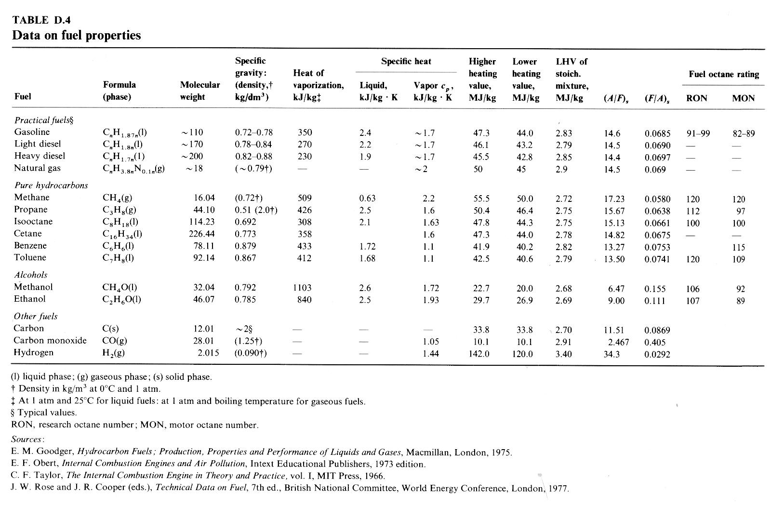
Heywood, J.B., Internal Combustion Engine Fundamentals, McGraw Hill, © 1988.

Slide 30
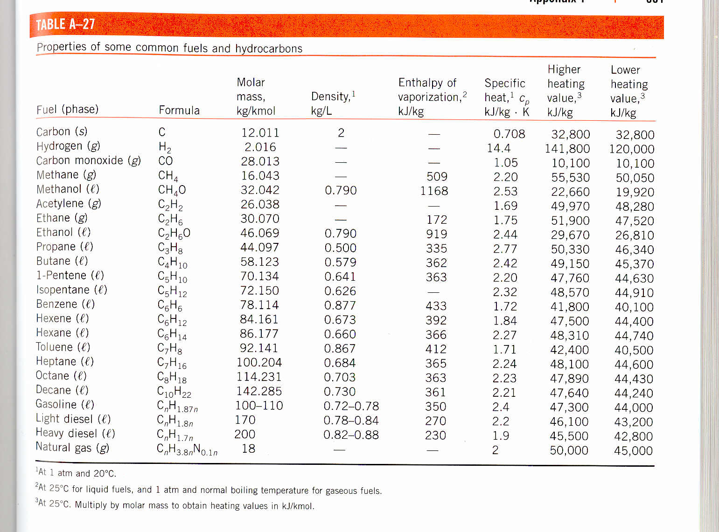
Additional Properties of Fuels

Slide 31
Energy

Slide 32
First Law of Thermodynamics

